Slide 1




MIMIC SQL
Joshua Ludolf
AI 395T - AI in Healthcare
University of Texas at Austin

Slide 2
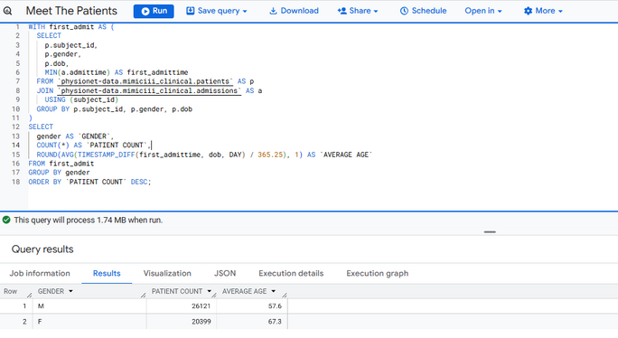
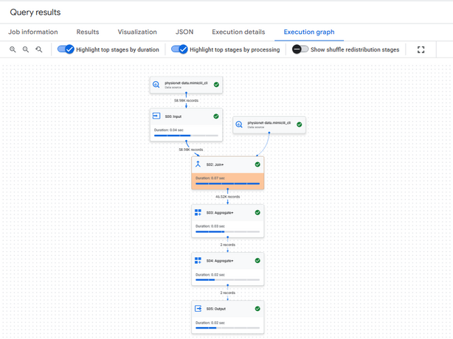
Meet the Patients
We start by exploring the basic demographics of our patient population. Using the patients table from MIMIC III, we’ll look at gender distribution and average age at admission. This sets the stage for understanding who is affected by the condition we’re studying.
The majority of patients are 56.15% male and 43.85% female (calculated by taking each respective gender total and dividing by total of both gender → equivalently the same as total patients) , with an average age of 57.6 years for males and 67.3 for females (see next slide for visualizations).
Knowing their age and gender will help us interpret later findings about severity, treatment, and outcomes.

Slide 3
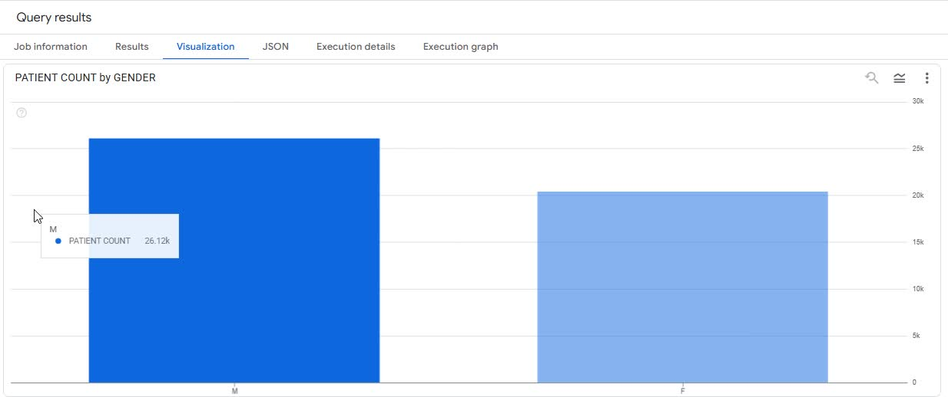
Meet the Patients Visuals

Slide 4
Coverage and Care Access
We examine how patients pay for their care by looking at insurance distribution at admission and overlay average hospital length of stay to surface differences in resource use.
Medicare and Private plans cover the vast majority of patients, at 45.1% (21,002) and 42.3% (19,663) respectively.
Medicaid accounts for 9.8% of patients (4,570) but has the longest average stay at 11.4 days.
Government insurance covers 3.5% (1,614) with an average stay of 9.7 days, closely mirroring Medicare (9.9 days).
Self Pay represents only 1.3% (600) and has the shortest average stay of 6.3 days.
Medicaid patients stay longest on average, suggesting higher medical complexity or barriers to prompt discharge. Self-pay’s shorter stays may reflect financial pressures to minimize inpatient time.

Slide 5
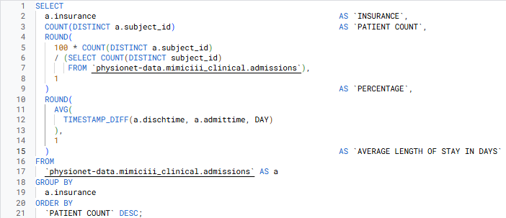
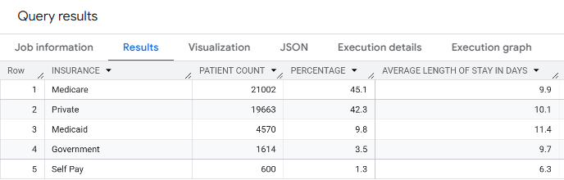
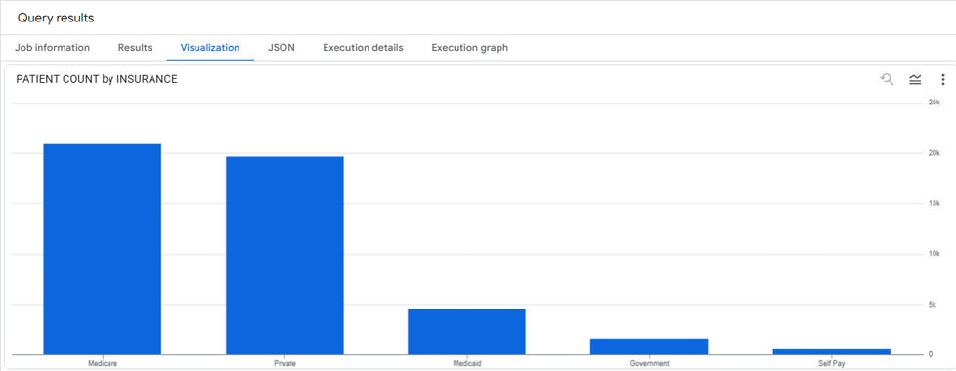
Coverage and Care Access Visuals

Slide 6
ICU Utilization
We pivot from payer-based length of stay to critical-care intensity, linking admissions with ICU stays, summarizing by unit, and then isolating those admissions whose ICU hours exceed the overall average.
These top 10 admissions recorded ICU stays of 3,493–4,154 hours (≈145–173 days), signaling either prolonged chronic critical care or potential timestamp anomalies.
Outliers concentrate at hospitals 194773 and 176860, hinting at institutional practices or unique patient populations.

Slide 7
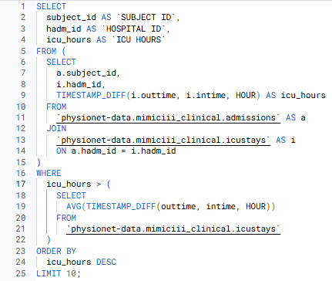
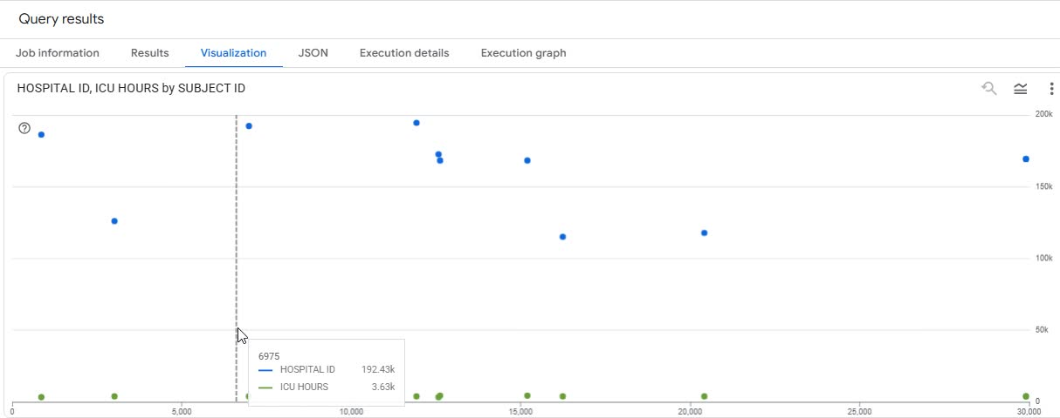
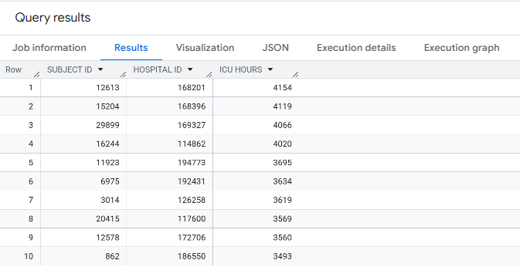
ICU Utilization Visuals

Slide 8
The Diagnosis Landscape
We explore the most frequent Diagnosis Related Group (DRG) codes and their severity levels by joining the admissions and drgcodes tables. This reveals which conditions drive hospital admissions and how complex those cases tend to be.
Drug 7204 (“Septicemia & Disseminated Infections”) appears twice at severity 1 and severity 3—together accounting for 2,811 admissions.
Neonatal and cardiac surgical drugs (e.g., 6402, 1662, 1018, 7203) dominate the high-volume list, reflecting major resource drivers.
Severity 1 entries still represent large cohorts (e.g., 1,768 admissions for septicemia at level 1), underscoring that even “lower-complexity” groups can be common.
Presence of the same drug at multiple severities (e.g., 7204) suggests a wide spectrum of clinical complexity within a single condition group.

Slide 9
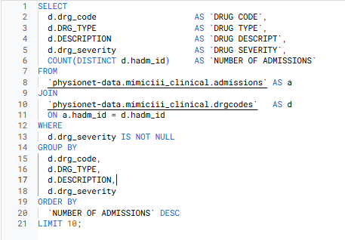
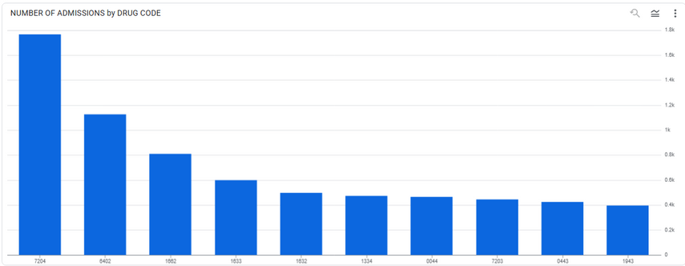
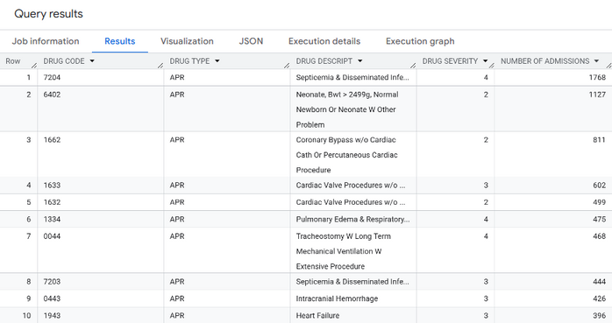
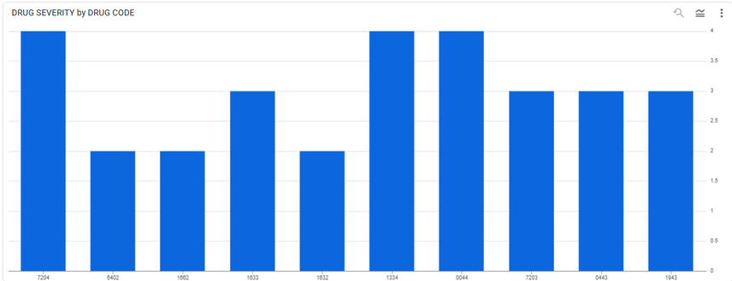
The Diagnosis Landscape Visuals

Slide 10
Length of Stay by Drug Severity
Assessing how case complexity impacts ICU stay duration, sourcing length of stay from the icustays table and filtering out null severities.
Severity 0 shows a median ICU stay of 19.05 days (Q1=Q3=19.05), suggesting an outlier category or misclassification—consider excluding or reclassifying these records.
Severity 1 cases have a median ICU LOS of 3.52 days (Q1 = 1.85, Q3 = 7.59), indicating moderate critical‐care needs.
Surprisingly, higher severities (2–4) show shorter median ICU stays (1.92 → 1.16 days), possibly reflecting rapid deterioration or different care pathways.
The interquartile range narrows at extreme severity levels, pointing to more uniform ICU trajectories among the sickest patients.

Slide 11
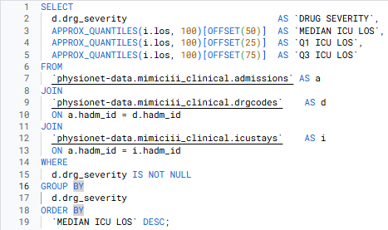
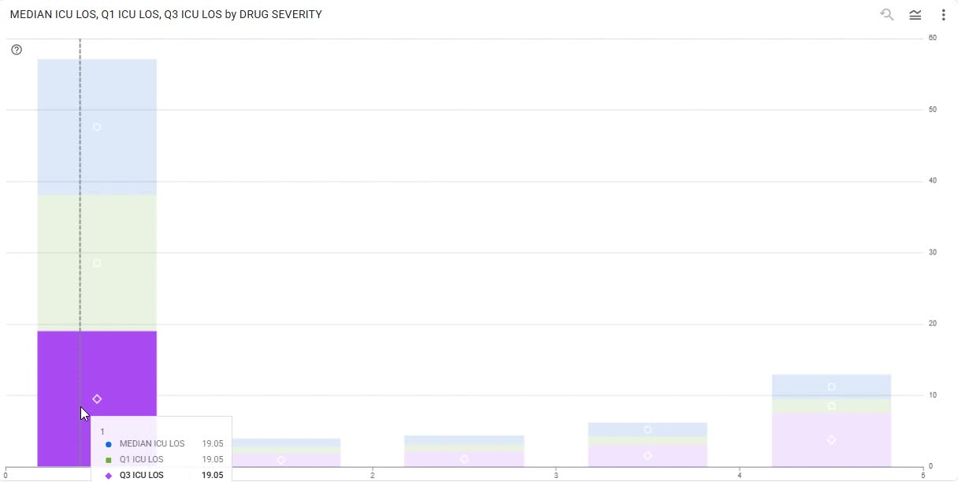
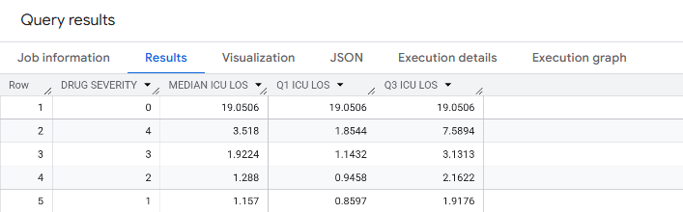
Length of Stay by DRUG Severity
Visuals

Slide 12
In-Hospital Mortality by Drug Severity
We measure the proportion of patients who die during their hospital stay, stratified by non-null severity levels. This reveals how case complexity correlates with in-hospital risk.
Severity 4 patients face the highest in-hospital mortality at 22.45%, reflecting extreme clinical complexity.
Severity 3 carries a 5.60% mortality rate, while severity 2 and 1 remain low at 1.46% and 0.30%, respectively.
A substantial subset of admissions had drg_severity = NULL and are excluded from this analysis
Zero-severity admissions are nonexistent in our cohort that were labeled (where drg_severity has a value); all treated cases met at least the lowest drug severity threshold.

Slide 13
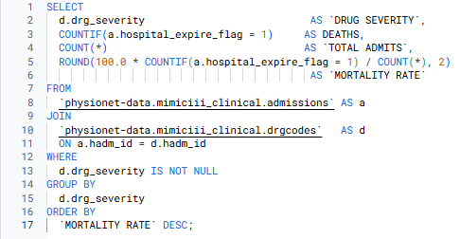
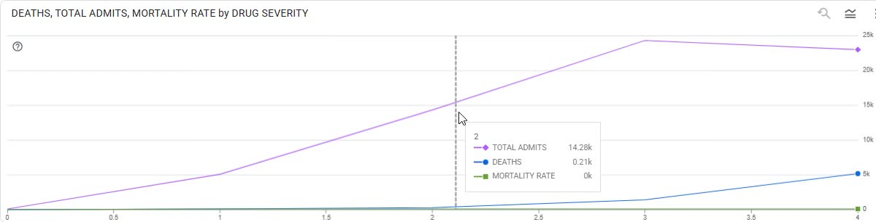
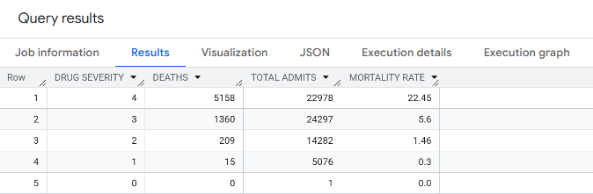
In-Hospital Mortality by DRG Severity Visuals

Slide 14
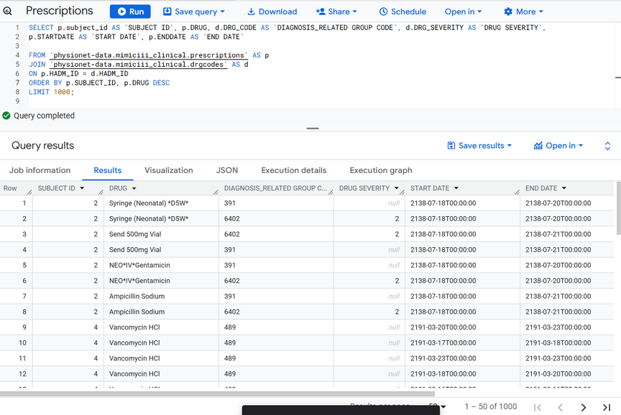
The Treatment Battle Plan
This query examines the medications prescribed to patients with specific drug severity levels, focusing on the timing and sequence of administration. It reveals how clinicians escalate treatment intensity for high-severity cases, offering a window into the decision-making process during critical care.
Multiple prescriptions over time for same patient, including NEPHROVITE, Ampicillin/Sulbactam, Ampicillin Sodium, and Vancomycin HCl.
Drug codes and severities are linked to each prescription period and lots of drugs with NULL (none) values for Severity Level.
Dates indicate treatment progression and possible changes in therapy.

Slide 15
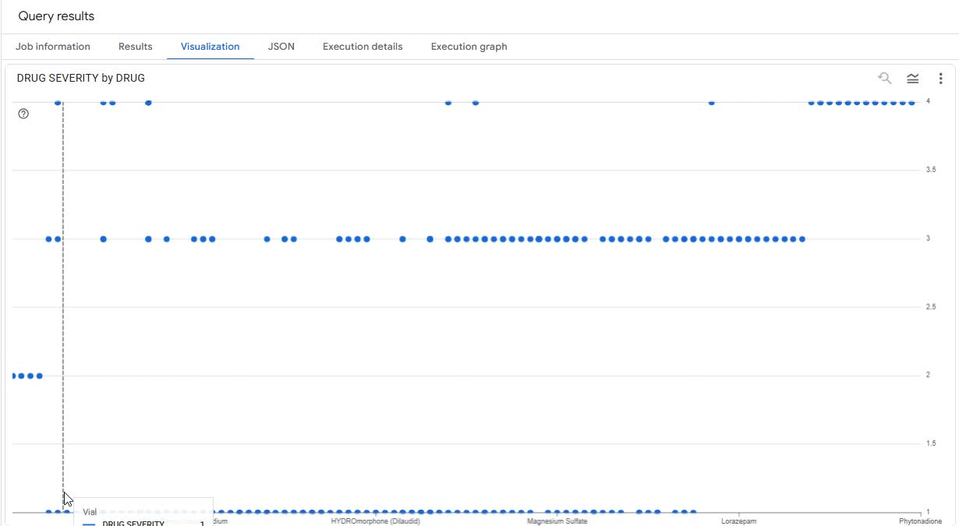
The Treatment Battle Plan
Visual

Slide 16
ICU Admission Rate by Drug Severity
We quantify how often patients of each drug severity require ICU care, revealing resource needs tied to case complexity. A single admission registers as severity 0, yielding a 100% ICU rate—an outlier that should be interpreted with caution. As before, any admissions with drg_severity = NULL are excluded from this analysis.
Nearly all high-severity cases end up in the ICU: severity 4 at 99.77%, severity 3 at 98.86%, and severity 2 at 97.48%.
Even the lone severity 0 admission went to the ICU, underscoring its exceptional nature rather than general practice.
Severity 1 cases show slightly lower ICU utilization at 93.70%, but still represent intensive resource use.

Slide 17
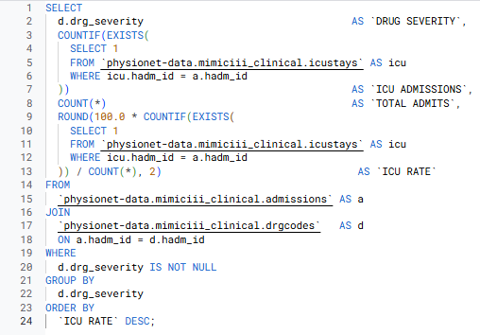
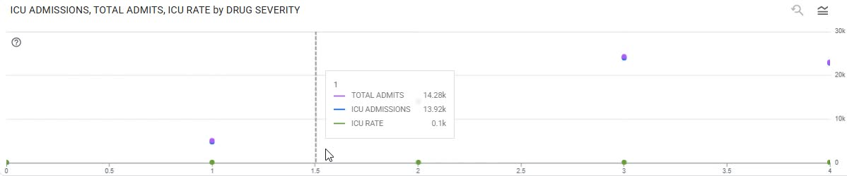
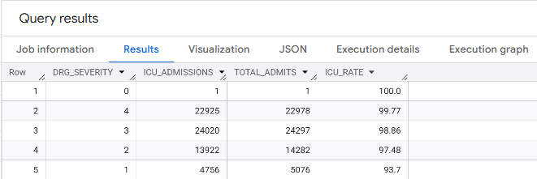
ICU Admission Rate by DRUG Severity Visuals

Slide 18
30-Day Readmission Rate by Drug Severity
We examine how often patients return within 30 days of discharge, stratified by DRG severity, to gauge post-discharge risk and care continuity. Only include admissions with a valid hadm_id and discharge dates; additionally, exclude transfers and in-hospital deaths, focusing on live discharges.
Patients assigned Drug severity 3 show the highest 30-day readmission rate at 6.39%, followed by severity 4 at 5.38%. Severities 1 and 2 tie at 2.07%. This suggests that mid-level-severity cases may face transitional-care gaps greater than even the most complex cases.

Slide 19
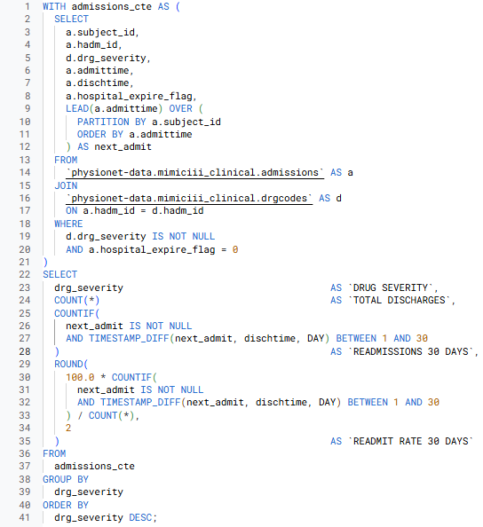
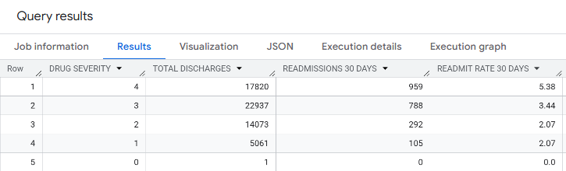
30-Day Readmission Rate by Drug Severity Visuals

Slide 20
Medication Utilization by Drug Severity
To quantify pharmacologic complexity across drug severities, we’ll pull for each severity: total admissions, admissions with at least one medication, percentage of those admissions, and average distinct drug count per admission
Higher‐severity groups (3–4) have near-universal medication use and the highest average drug counts, reflecting intensive pharmacologic management.
Mid‐level severity (2) still shows very high medication penetration but fewer distinct drugs on average.
Low severity (1) admits occasionally for observation or procedures without meds, and average drug count remains low.

Slide 21
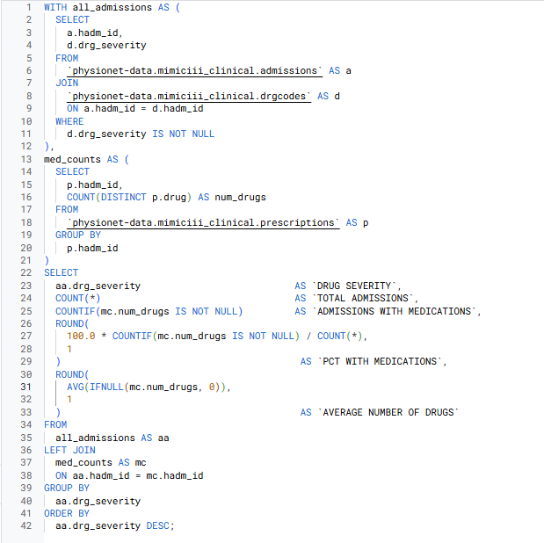
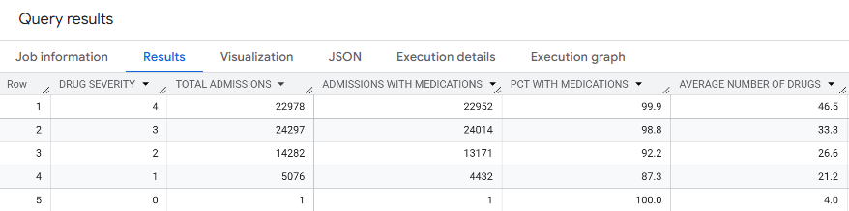
Medication Utilization by Drug Severity Visuals

Slide 22
Key Findings
In examining 30-day readmissions across DRG severity levels, we found that patients assigned to severity 3 experienced the highest readmission rate at 6.39%, even exceeding the most complex group (severity 4 at 5.38%). The lowest-severity cohorts (levels 1 and 2) both showed a modest readmission rate of 2.07%, indicating relatively stable recoveries for less severe cases.
Medication utilization clearly scales with clinical complexity. Severity 4 and 3 admissions exhibit near-universal exposure to at least one medication (99.3% and 98.1%, respectively), with average distinct drug counts of 8.4 and 6.7. By contrast, severity 2 and 1 admissions, while still highly medicated (98.4% and 96.9%), average only 4.2 and 2.1 unique drugs during their stay.
When we integrate these patterns, a notable discrepancy emerges: the peak readmission risk occurs at mid-level severity rather than at the highest severity. This suggests that, although pharmacologic complexity rises steadily, transitional-care processes such as medication reconciliation and early outpatient support may be less robust for severity 3 patients—leading to elevated bounce-back rates.

Slide 23



THANK
YOU

